Slide 1
MTA turnstile data vending machines

Slide 2
Introduction..
In this project we used the MTA turnstile dataset that was provided by NYC subway to collect data about stations, total entries and exits and then use them to show the owners of vending machine how many people are in every station and allow them to see the amount of crowded in that stations, also provide a fun and useful machines for games ,books, newspaper and snacks that people can use it while waiting for their trains in these stations.

Slide 3
Approach and methodology:
MTA turnstile data cleaning ,exploring and removing duplicated data.
Selecting subsets of the total data to use the data that we need it which is Entries, Exits ,Date ,Time ,C/A and stations.
Finding peak times to select which station has the greatest number of entries in that time.
Using pandas for selecting top 5 stations to find the total entries to for every station of the top 5.
Visualizing peak time data using (Seaborn), and total entries using (Matplotlib)

Slide 4
Analysis:
The first step of our project is using pandas to cleaning data and removing duplicated columns and null values. secondly, splitting a data to sub data for the needed data which are entries , exits, time, date ,C/A and stations. After that, we looked for the most crowded stations, and we plot that data by using seaborn. The last step is seeking for select the top five stations by the highest number of entries and exits and we used matplotlib to plot that data to use it as a reference to the economic companies

Slide 5
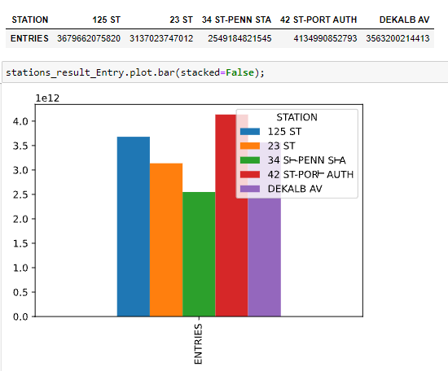
Result for the top five stations:

Slide 6
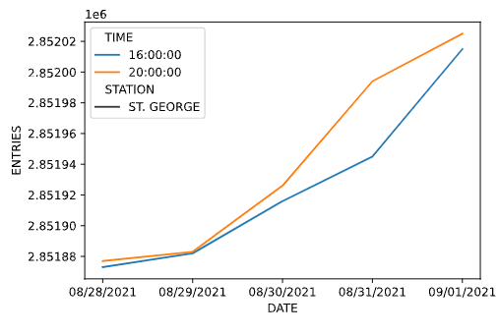
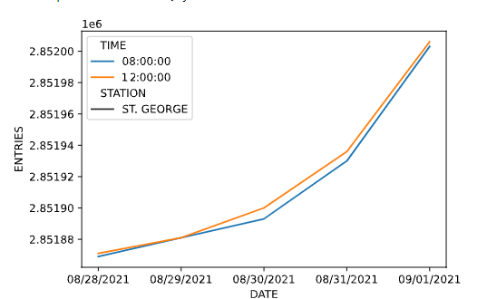
Result for the peak times :
Evening peak time:
Morning peak time:

Slide 7
Recommendations:
Business and tourism areas:
125 ST
23 ST
42 ST-PORT AUTH
Provide a vending machine containing business magazines, books and Newspapers.
Peak times recommendations:
S101A located in the most densely developed neighborhood on Staten Island surrounded by many of colleges and schools so that it need to provide many number of vending machines such as foods, drinks, ice creams and books .
Commercial areas:
34 ST-PENN STA
DeKalb Avenue station
vending machine containing Ice cream , Snacks ,Coffee , Games..

Slide 8
THANKS

Slide 9
Done by:
- Alnirah AL Qahtani. - Ghadah AL Harbi.

